Slide 1
a2g generator
Creates ids, and binding code from a folder structure of game images

Slide 2
sourceimages
The game is made from images.
But the images are never checked in.
Instead, they are rendered from the 3D file, in to a folder structure of pure PNGs
Then this structure is processed with generator.exe
The input to generator is a folder called “sourceimages”

Slide 3
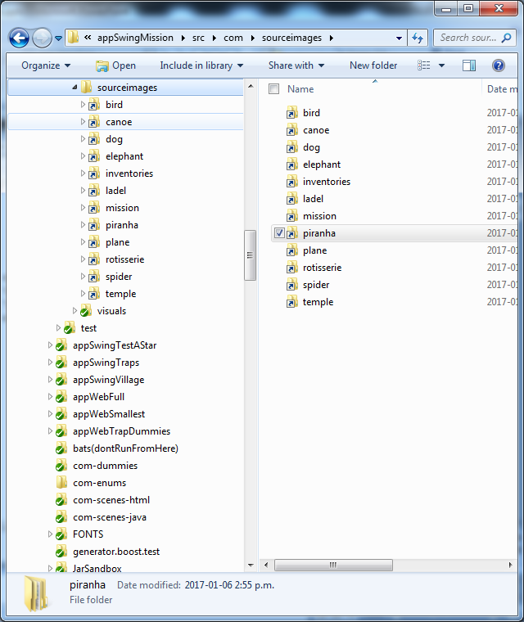
LOCATIONS
The subfolders of the “sourceimages” folder are called LOCATIONs.
These do nothing other than make it easier for if your game is too big.
Most of the time, games can exist in a single LOCATION, but if a game gets too big and generator.exe takes ages, then a games scenes can be split in to separate locations and generator command line can point to the location folder, instead of “sourceimages”
Note: generator.exe can only be run on “sourceimages”, or an immediate subfolder thereof.
← “sourceimages”
← “bird”, “canoe”, “dog”, “elephant”, “inventories”, “ladel”, “mission”, “piranha”, etc are called LOCATIONs

Slide 4
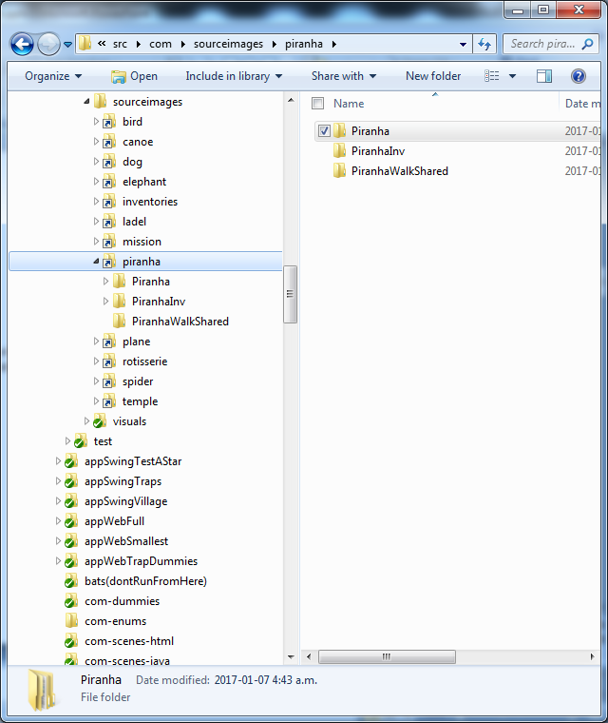
CAMERAS
The subfolders of a location are called its CAMERAs.
For every folder , OnlyLoader.java file is created
In addition to these:
If a camera has “Inv” in its name, then it is treated as an inventory file, and an I.java file is created. These are used in game code to identify inventory items.
If a camera has “shared” in its name, then no
Note: Cameras are called cameras because each is the output from a single camera in a 3D package. Sometimes the cameras are from the same 3D scene file, sometimes they aren’t.
← “Piranha”, “PiranhaInv” and “PiranhaWalkShared” are all CAMERA folders.

Slide 5
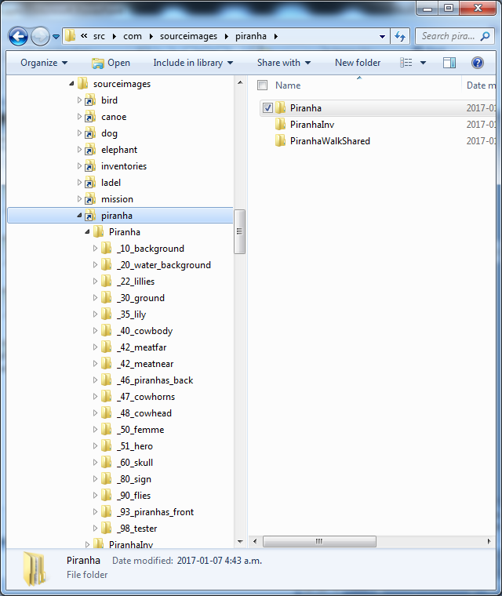
OBJECTS
The subfolders of a camera are called its OBJECTs.
Object’s can be thought of as analgous to layers. The scene is rendered by layering each layer on top of each other, starting alphanumerically.
It makes sense to use number prefixes.
The underscore preceding the number doesn’t make much sense yet... Let’s just says its needed if this folder structure is to be used in GWT.
← All these folders with number prefixes are called OBJECTs

Slide 6
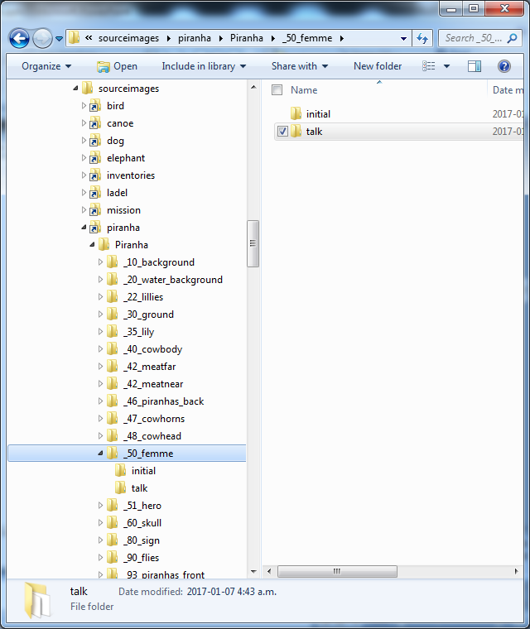
ANIMATIONS
The subfolders of an object are called its ANIMATIONs.
Every image in the engine exists as part of an animation... Even if its just a single frame animation.
Only a single image from, a single animation, from each of the objects is ever displayed at one time.
When a scene is loaded, the first frame from the animation entitled “initial” is displayed.
← These folders are called ANIMATIONs

Slide 7
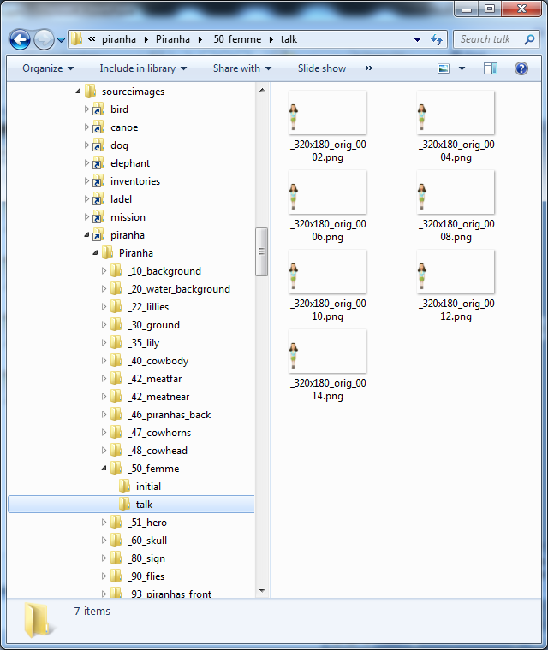
PNG files
..and the animation folder contains PNG files.
.In this scene this game character stands to the left of the scene, and talks. Notice how this character has been rendered in place in the scene she is standing in – and there is a lot of wasted image space?
One of the jobs the generator does when it processes this folder structure, is to trim away the white space. IT does this whilst recording her positioning information in a java file, so the scene is easy to reconstruct.

Slide 8

visuals
Now we turn our attention to the “visuals” folder.
“visuals” is where generator.exe outputs its results.

Slide 9
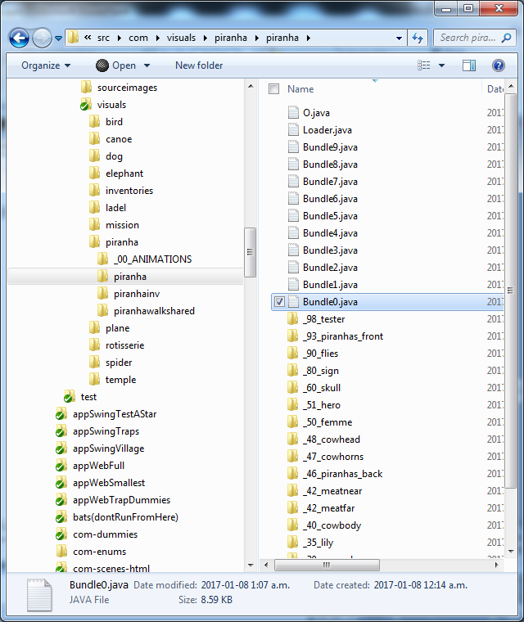
Bundle.java
Every subfolder that contains useful PNGs will have Bundle.java files generated.
These split the images in to easily loadable bundles. These are prompted by a useful download optimization of GWT, but the similar style is mimicked in Swing for the sake of coherence.
At the most there are 10 of these. This number was arrived at using trial and error whilst trying to get the best progress bar response.

Slide 10
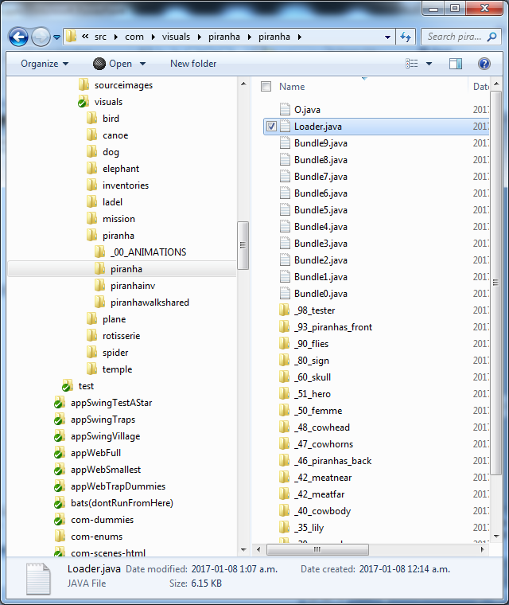
Loader.java
Every subfolder with one or more bundles will also get an OnlyLoader.java
OnlyLoader.java, these take care of loading the bundles asynchronously.

Slide 11
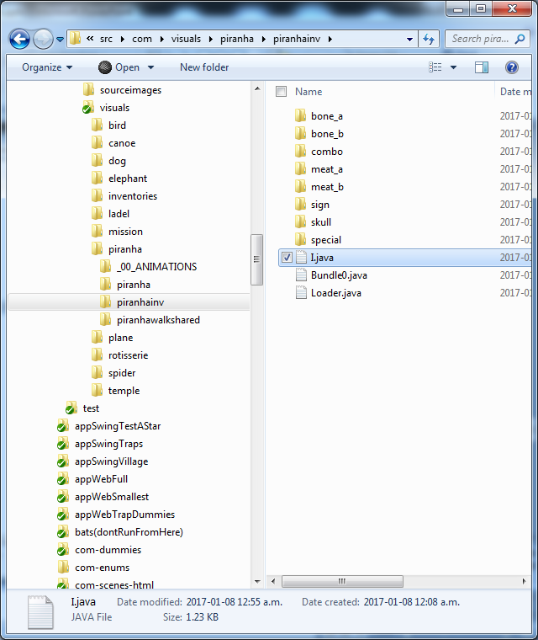
I.java
Each CAMERA folder containing “inv” in the title ends up with an I.java in it. The I.java contains ids for all of the subfolders of such a folder. In this case they are used to identify the inventory items, that the subfolders represent.
The Ids are a specially generated number that will generate unique products when multiplied with the objectIds in the I.java. This is then useful to handle object X inventory interactions.
Runtime methods of a2g API that consume these Ids will generate runtime errors unless the Loader.java file from the same folder has been loaded for the current scene.

Slide 12

O.java
Each CAMERA folder without “inv”, and without “shared” in the title ends up with an O.java in it. The O.java contains ids for all of the subfolders of such a folder. In this case they are used to identify the OBJECTs, that the subfolders represent.
The Ids are a specially generated number that will generate unique products when multiplied with the inventoryIds in the O.java. This is then useful to handle object X inventory interactions.
The “shared” cameras don’t have an O generated because they are designed to be added to other scenes, and as such they use the O file of their master scene, and don’t need an O file.
Runtime methods of a2g API that consume these Ids will generate runtime errors unless the Loader.java file from the same folder has been loaded for the current scene.

Slide 13
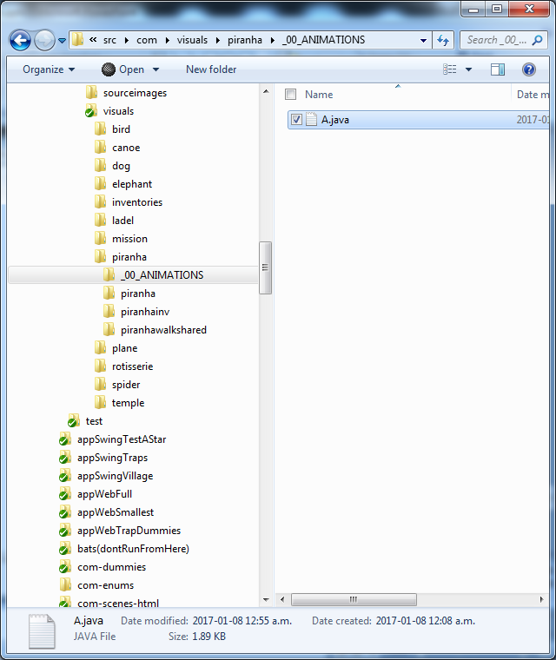
A.java
Each location ends up with an A.java file inside it. It is a list of ids for all of the ANIMATIONs for all of the OBJECTS.
The Ids are just a concatenation of the object name and the animation name. And since object names are unique within a CAMERA, and animation names are unique within an OBJECT, then the animation Id is unique.
The A.java is found in an additional folder called _00_ANIMATIONS that is created. This serves no purpose other than to make the A.file easier to navigate to: instead of being a file that gets lost amongst the many other folders in the piranha folder, it.

Slide 14
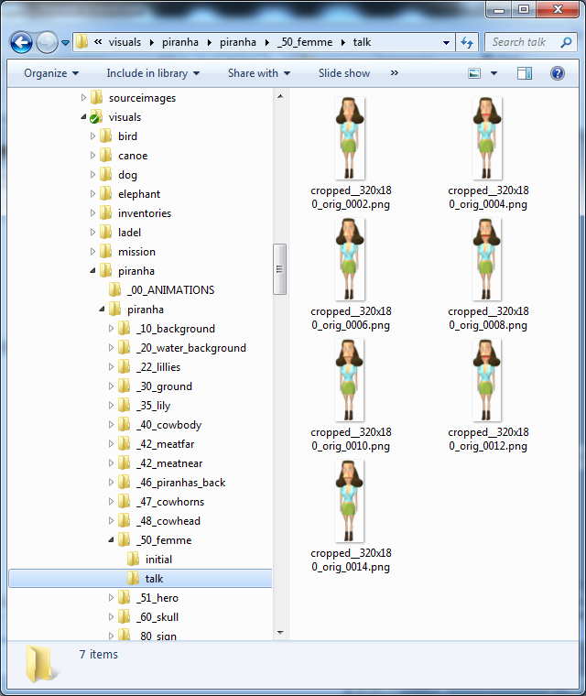
PNG files
The generator.exe also modifies the PNG files.
Notice how the files from the sourceimages are now cropped to their most compact representation?
This saves bandwidth and memory at runtime.

